Slide 1
Employee Data Analysis using Excel
STUDENT NAME: VISHAALI U H
REGISTER NO:312215900 asunm1621312215900
DEPARTMENT: III B COM A & F A
COLLEGE:SHRI SHANKARLAL SUNDARBAI SHASUN JAIN COLLEGE FOR WOMEN

Slide 2
PROJECT TITLE
Employee Performance Analysis using Excel

Slide 3


AGENDA
Problem Statement
Project Overview
End Users
Our Solution and Proposition
Dataset Description
Modelling Approach
Results and Discussion
Conclusion
3/21/2024 Annual Review

Slide 4

PROBLEM STATEMENT
●To address issues, we need to analyze the existing employee performance evaluation system to identify weaknesses and areas for improvement. The goal is to develop a more consistent, transparent, and fair performance evaluation process that accurately reflects employee contributions, aligns with organizational goals, and supports overall employee development and satisfaction.
●The analysis will include a review of the current evaluation criteria, feedback from employees and managers, and an assessment of how performance data is used in decision-making. It will involve a comparison of performance outcomes with evaluation ratings and the development of recommendations for improving the system.

Slide 5

PROJECT OVERVIEW
Enhanced ability to monitor and evaluate employee performance. Improved decision-making regarding employee development, rewards, and interventions. Increased efficiency in generating performance reports and insights. Greater transparency in performance evaluation processes, leading to more motivated and engaged employees. By leveraging Excel's capabilities for data analysis and visualization, this project aims to provide a scalable and cost-effective solution for employee performance management, supporting organizational goals and fostering a culture of continuous improvement.

Slide 6

WHO ARE THE END USERS?
1. Human Resources (HR) Departments
2. Managers and Supervisors
3. Executives and Senior Management
4. Employees
5. Training and Development Teams
6. Compensation and Benefits Teams
7. Consultants and Analysts

Slide 7

OUR SOLUTION AND ITS VALUE PROPOSITION
Your solution leverages Excel to provide a comprehensive, user-friendly, and cost-effective approach to employee performance analysis.
Value Proposition:
1. Cost-Effectiveness
2. Ease of Use
3. Data Management
4. Customizable Analysis
5. Real-Time Analysis

Slide 8
Dataset Description
Listed Features:
1. Employee ID
2. First name
3. Last name
4. Business unit
5. Employee Type
6. Employee Status
7. Employee classification type
8. Gender Code
9. Performance Score
10. Current employee rating

Slide 9

THE "WOW" IN OUR SOLUTION
Interactive Dashboards
2. Data Visualization
3. Automated Reporting
4. Predictive Analysis
5. Scorecards and Balanced Scorecards
6. Employee Ranking and Comparison
7. Training and Development Analysis
8. Employee Feedback and Sentiment Anlysis
9. KPI Tracking with Alerts
10. Data Security and Privacy
3/21/2024 Annual Review
9

Slide 10
MODELLING
Data Collection:
Data sourced from Edunet dashboard.
2. Feature Collection:
The listed 10 features selected for analysis.
3. Data Cleaning:
Handling missing values.
4. Calculation of Performance Level:
Using employee rating to determine performance.
5. Summary of Pivot Level:
Organizing data using pivot tables.
6. Visualization:
Graphical representation using pivot tables.
10

Slide 11
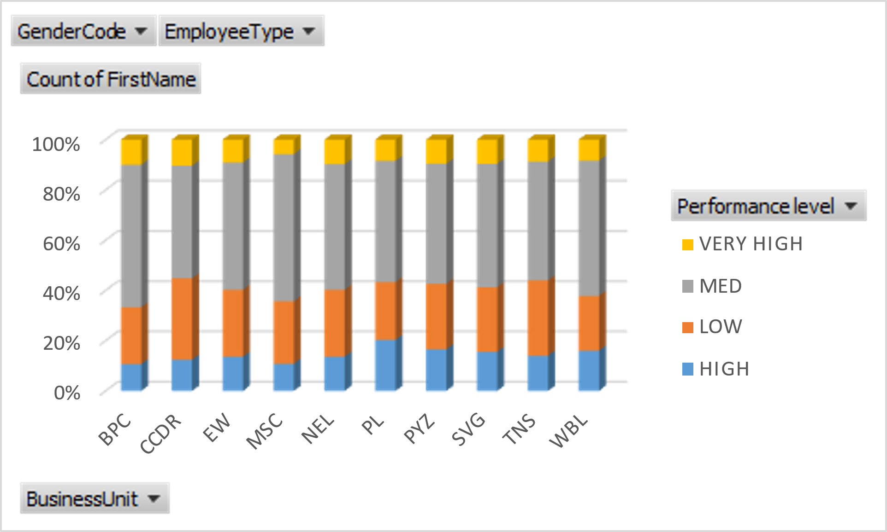
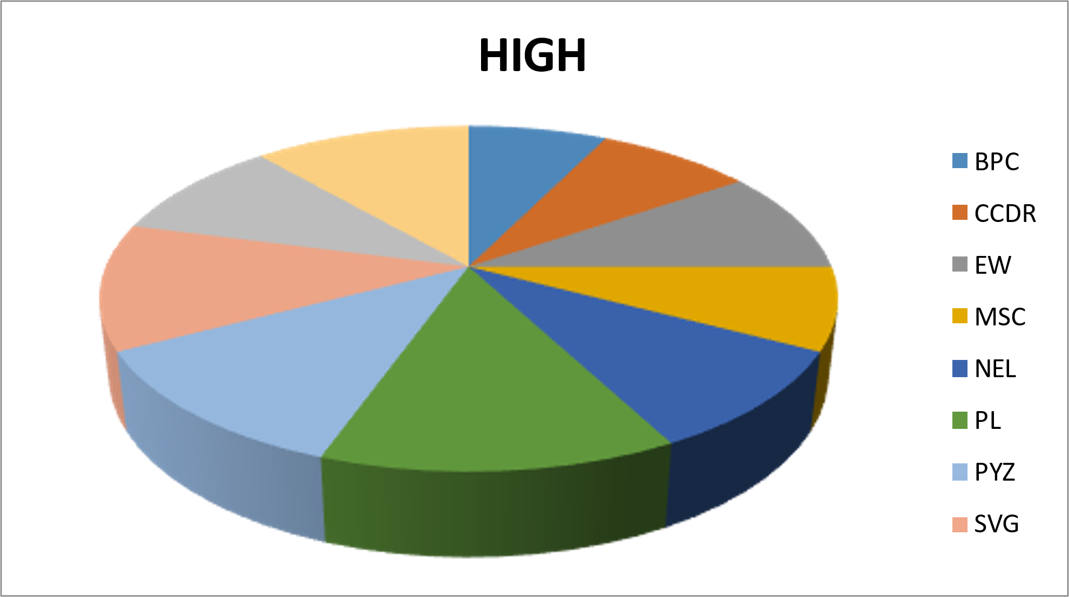
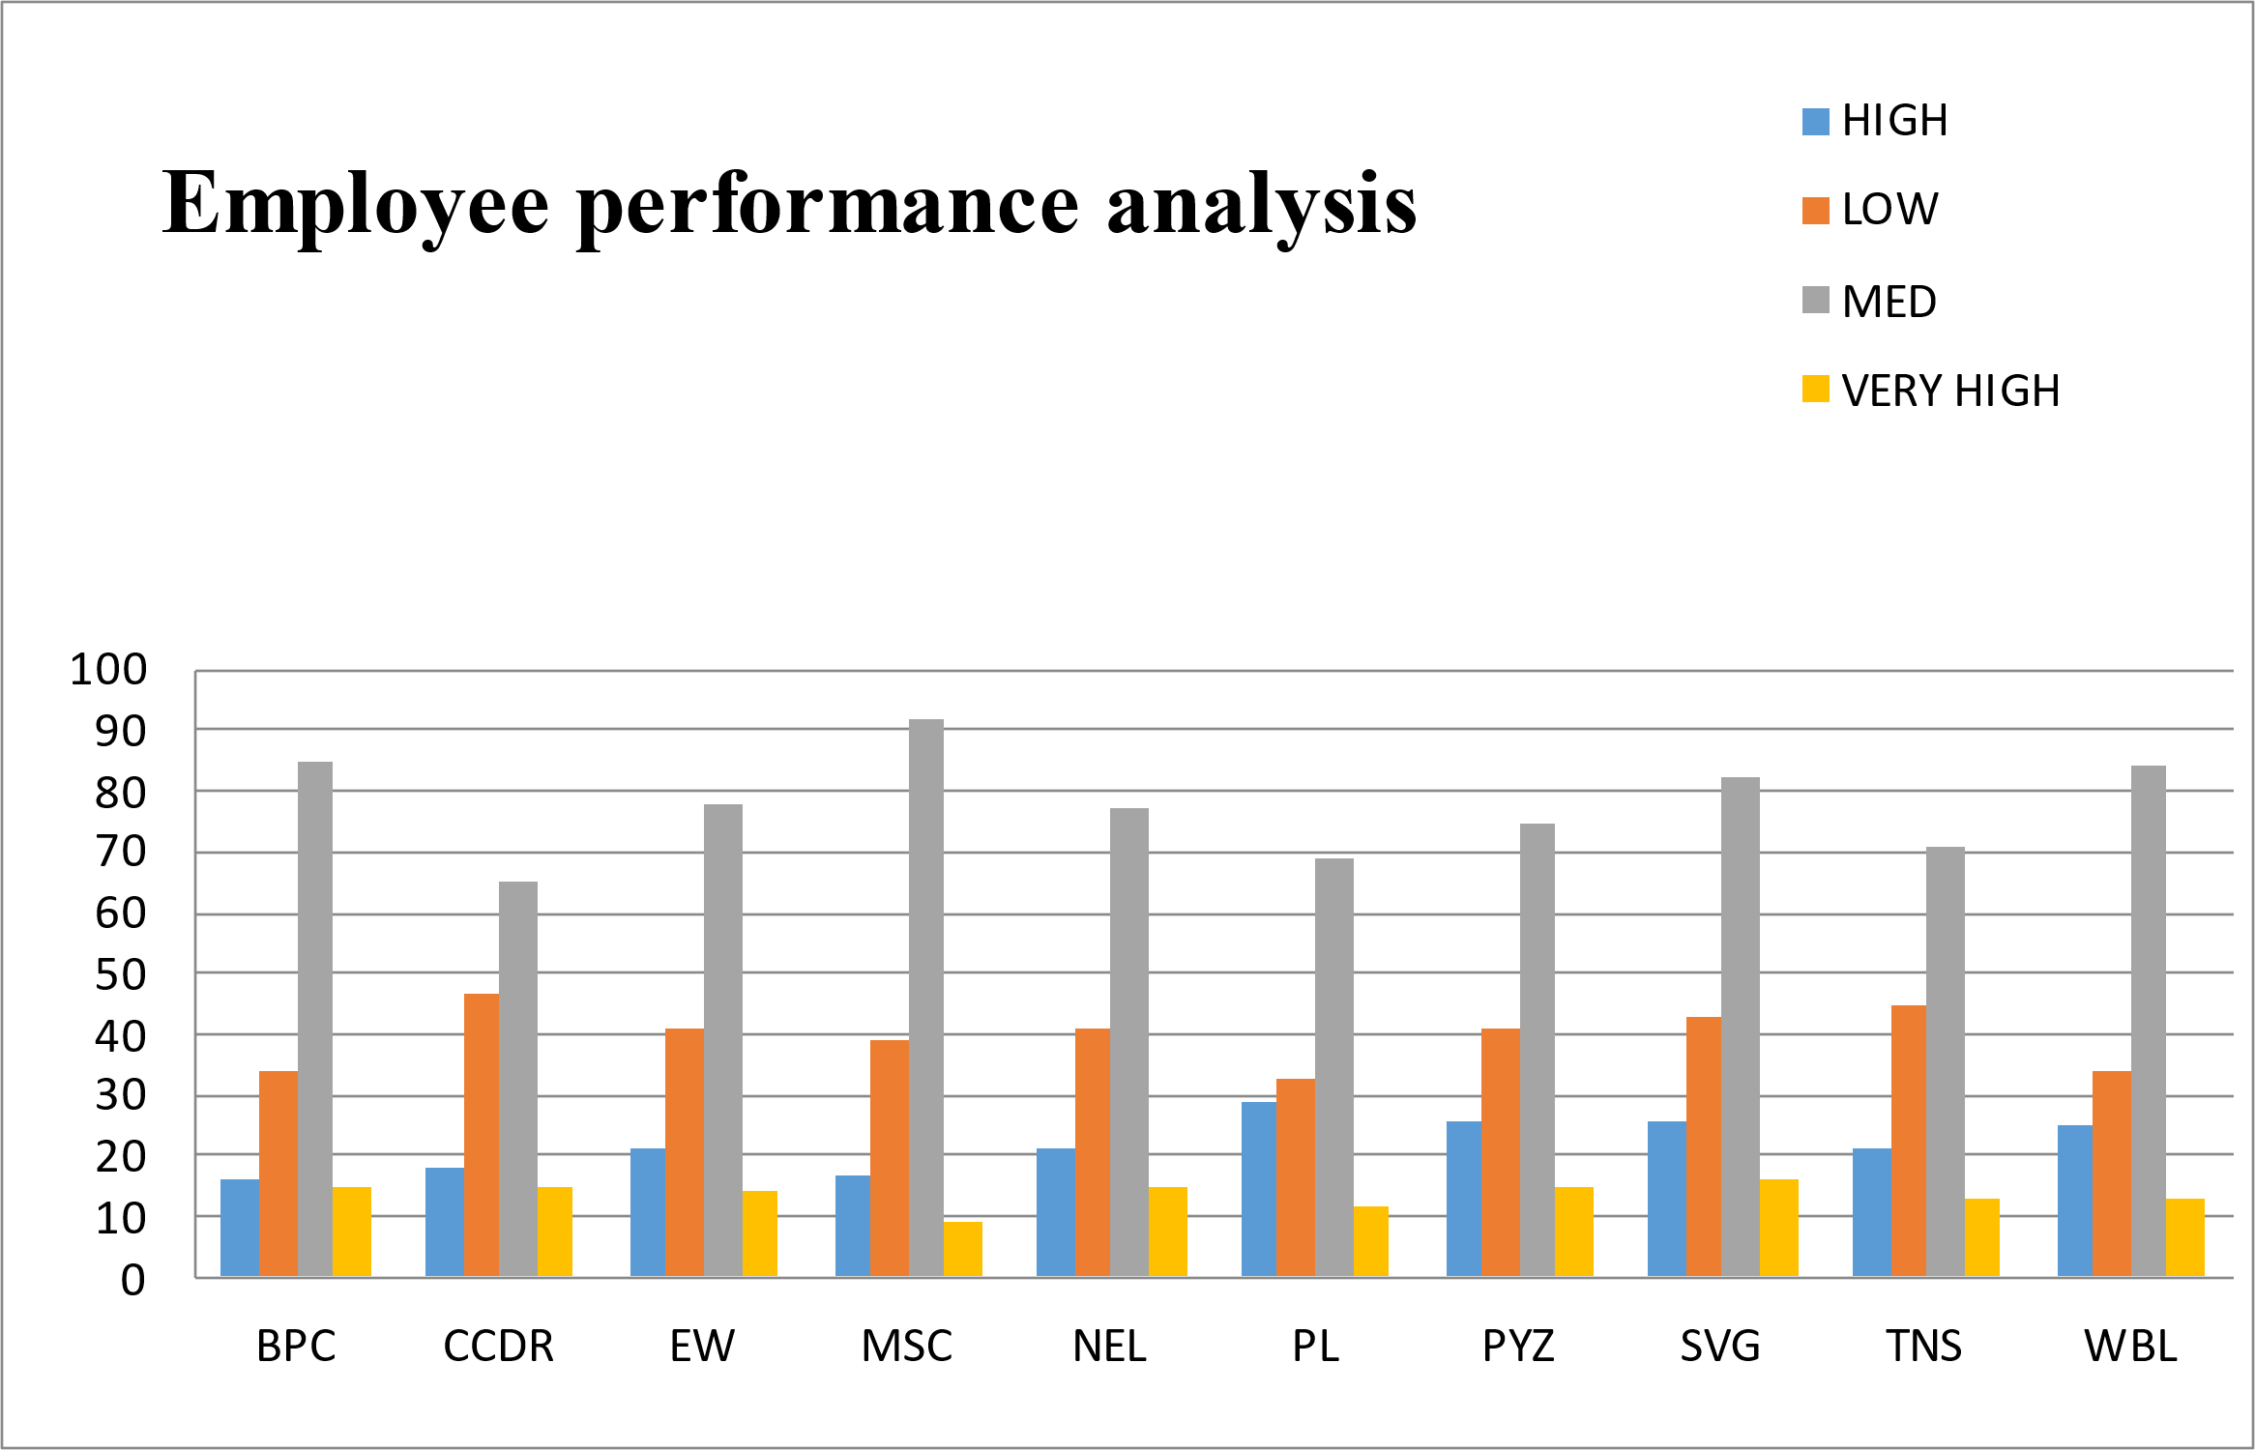
RESULTS
=IF(AND(Z8>=5),"VERY HIGH",IF(AND(Z8>=4),"HIGH",IF(AND(Z8>=3),"MED","LOW")))
11

Slide 12
Conclusion
The employee data analysis conducted using Excel has provided valuable insights into workforce performance and trends within the organization. By systematically collecting, cleaning, and analyzing key employee data, we have been able to:
Identify Performance Trends
2. Highlight Key Metrics
3. Utilize Advanced Excel Tools

